Slide 1


Slide 2
Heatree overview video
http://heatreeactivitycentre.co.uk/

Slide 3
Departure and return
Leaving school at 10am on Monday 19th March (be in school at the usual time)
Returning by 3.15pm on Wednesday 21st March

Slide 4
Activities
Climbing tower
Orienteering
Low adventure (assault course)
Wilderness Venture (exploring Dartmoor)

Slide 5
Food and clothing
Children will need to bring a packed lunch on the Monday
All other food will be provided (including lunch on the Wednesday)
They will need a sleeping bag or duvet cover (single duvets are provided)
They should wear old clothes to school as they will be taking part in their first activity shortly after arrival
A full kit list will be provided

Slide 6
Health and Safety video
http://heatreeactivitycentre.co.uk/

Slide 7
Other
Please do not send children in with chocolates, sweets, fizzy drinks etc.
We will expect children to stay in their rooms except in emergency. A good sleep on the first night is essential!
No electronics please.
We will allocate rooms. Please be flexible but let us know of any major concerns.
Please make sure we have up-to-date information on medical/allergy/dietary needs (we will send out a form shortly).
Please bring any medication into school on Friday 16th March. Make sure it is clearly labelled with your child’s name and dosage instructions in a waterproof, sealable bag.
Please let us know of any special considerations regarding your child.

Slide 8
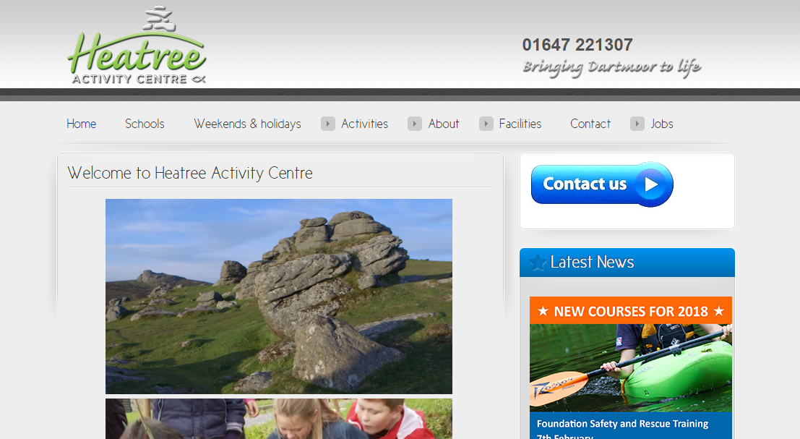
Further details (including contact details) http://heatreeactivitycentre.co.uk/

