Slide 1


Spelling, Punctuation and Grammar
Click this symbol whenever you see it to listen to instructions!
Adjectives with -er and -est
Year One
SPaG | Adjectives with er and est

Slide 2
How to use this slideshow
Press the F5 key at the top of the keyboard to begin.
Then press the ← and → keys to move through the slides.

Slide 3
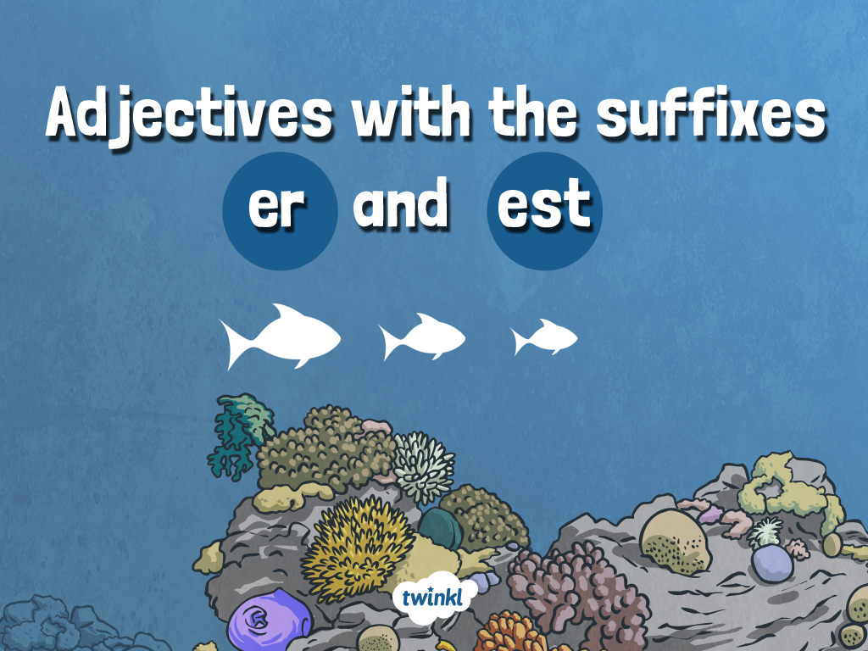

Slide 4
Aim
To use the suffixes -er and -est correctly in adjectives.
Success Criteria
I can use the suffixes -er and -est to compare things.
I can add the suffixes er and est to an adjective.

Slide 5
For this lesson you will need:
A pencil
A blank piece of paper
Monday activity sheet

Slide 6

Recap

Slide 7

What is an adjective?
Tell the person next to you, then press the → button to see if you were right.

Slide 8
An adjective is a describing word!
In school we use a paintbrush to remind us to use adjectives. This is because a paintbrush adds colour to a picture to make it more interesting, just like we use adjectives to make our sentences more interesting too.

Slide 9
An adjective is a describing word!
The hungry rabbit was eating a massive carrot.

Slide 10
Introduction Activity

Slide 11

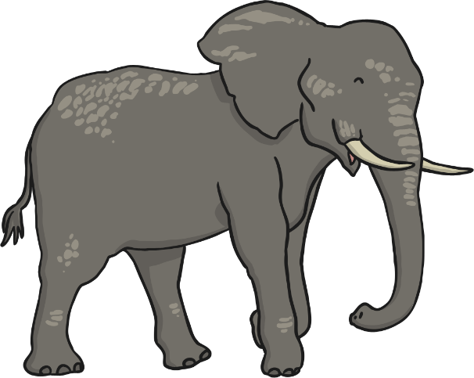
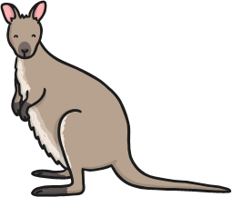

Comparative Adjectives
Look at these pictures. What do you notice?
strong
stronger
strongest

Slide 12
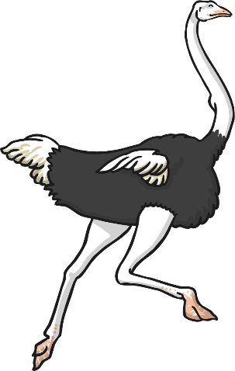
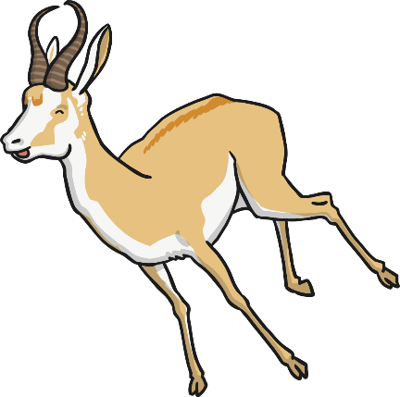
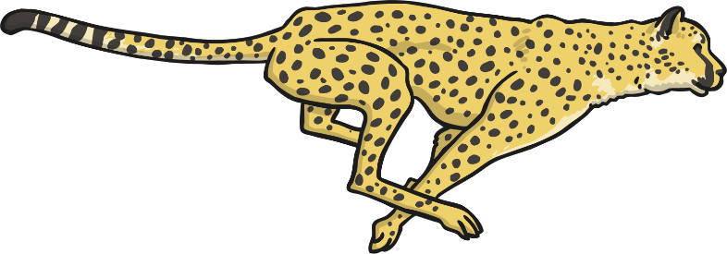
Comparative Adjectives
Now look at these pictures. What do you notice?
fast
faster
fastest

Slide 13




Comparative Adjectives
We call these adjectives comparative and superlative adjectives.
fast
faster
fastest
When we compare two things we use comparative adjectives.
Y2: When we compare three or more things we use superlative adjectives.

Slide 14

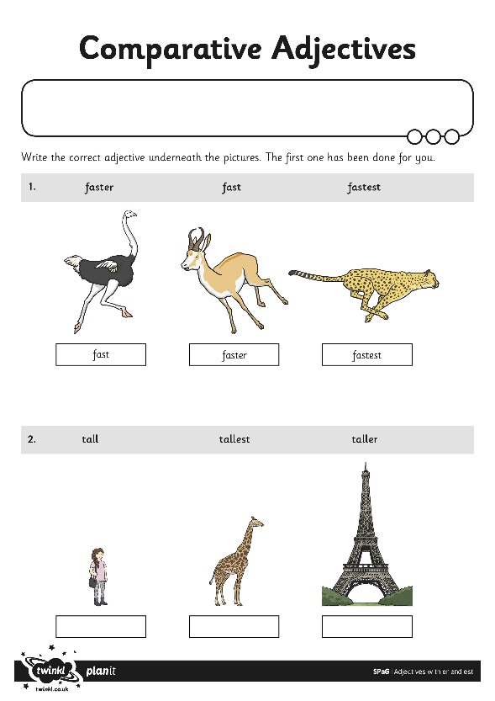
Comparative Adjectives
Complete the Comparative Adjectives activity sheet

Slide 15
Now take a look around your house and find 3 objects you can compare.
You could compare the size of 3 pieces of fruit with big, bigger and biggest, or small, smaller and smallest.
Or maybe you could compare 3 teddy bears and call them soft, softer and softest?
What will you find?

